Slide 1




Project
Technologies
Process
Graphs
The End
Summarize
Summer Internship
Done by
Dune Krishna Sai Manikanta Dora

Slide 2



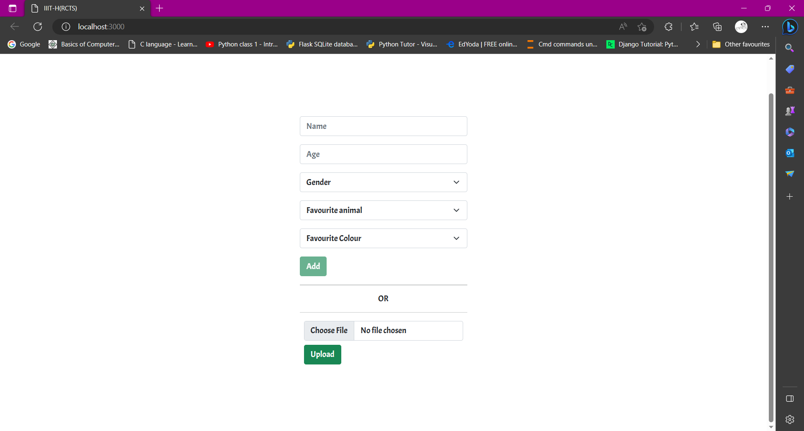
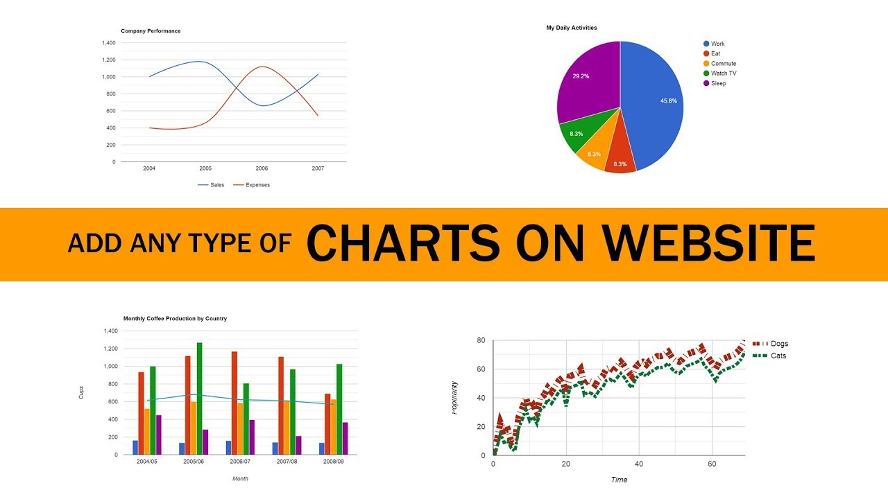
Project
Technologies
Process
Graphs
The End
Summarize

Slide 3
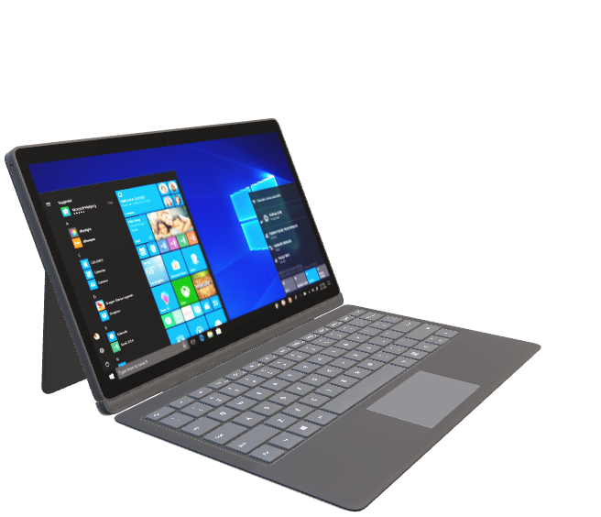
Project
Technologies
Graphs
The End
Process
Summarize
Frontend :
React
React Google Chart
React Router Dom
Data Base:
MongoBD
Backend :
Python
Flask
Flask CORS
PyMongo
Pandas

Slide 4
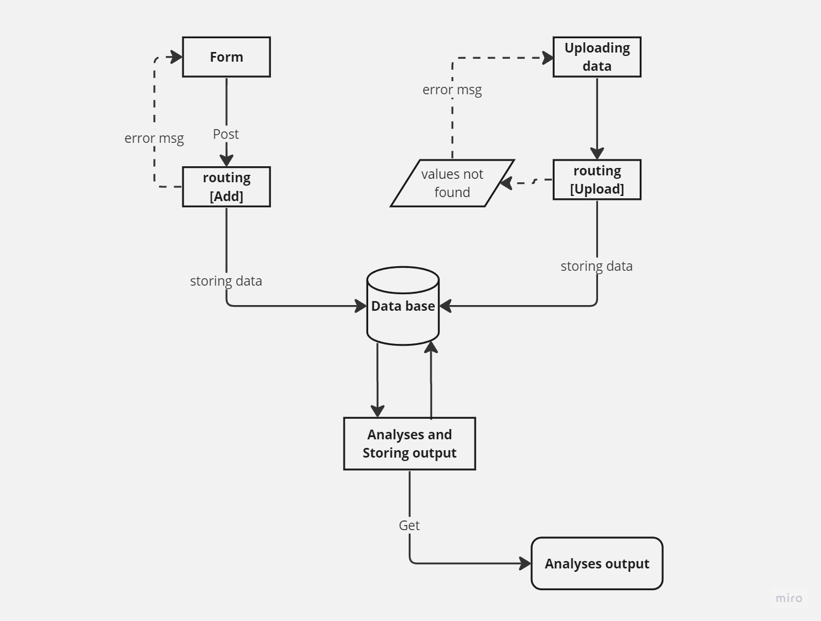
Project
Technologies
Process
Graphs
The End
Summarize

Slide 5
Home
Technologies
Process
Graphs
The End
Summarize

Slide 6

Project
Technologies
Process
Graphs
The End
Summarize
Thank you

